Slide 1
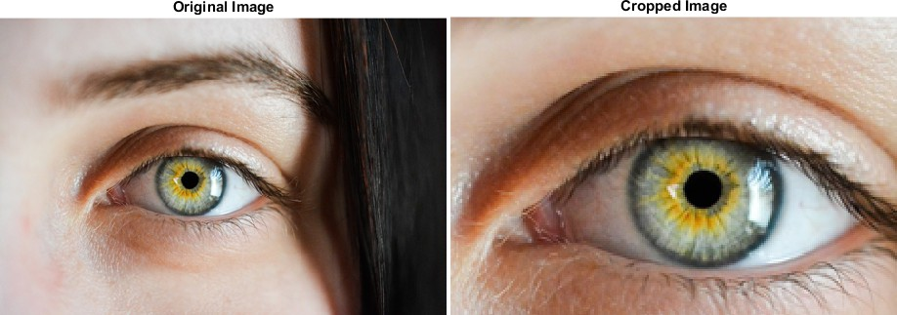
Image Image Data Basic Image Manipulation Histogram Image Segmentation Noise in images
Image Crop
Image crop in color
Exercise: What changes are required in Python code (previous slide) to achieve this result.

Slide 2
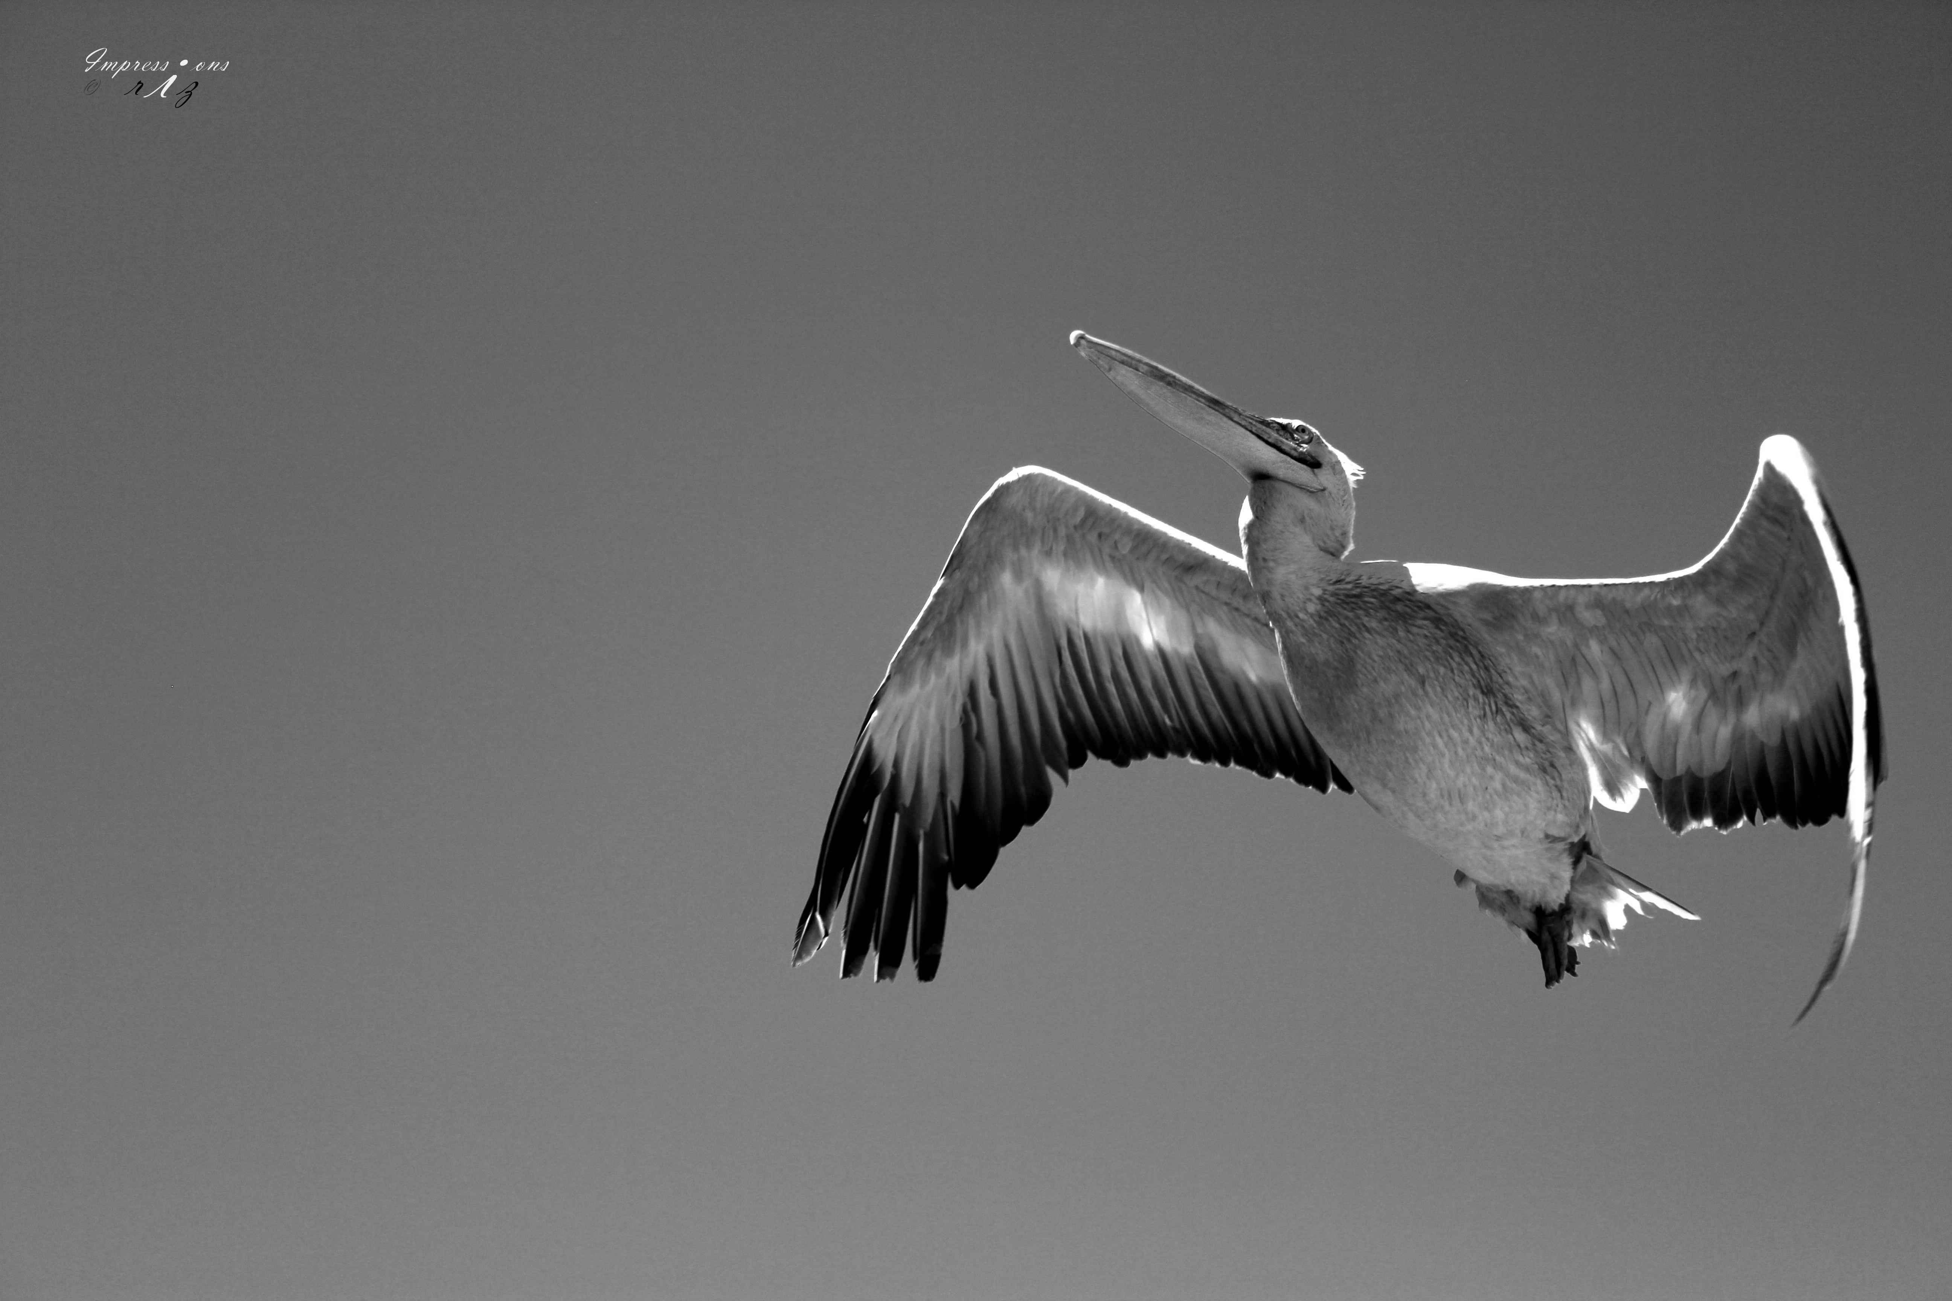
Image Image Data Basic Image Manipulation Histogram Image Segmentation Noise in images
Image Addition
Addition of two images
Original Image 1
31 / 92

Slide 3
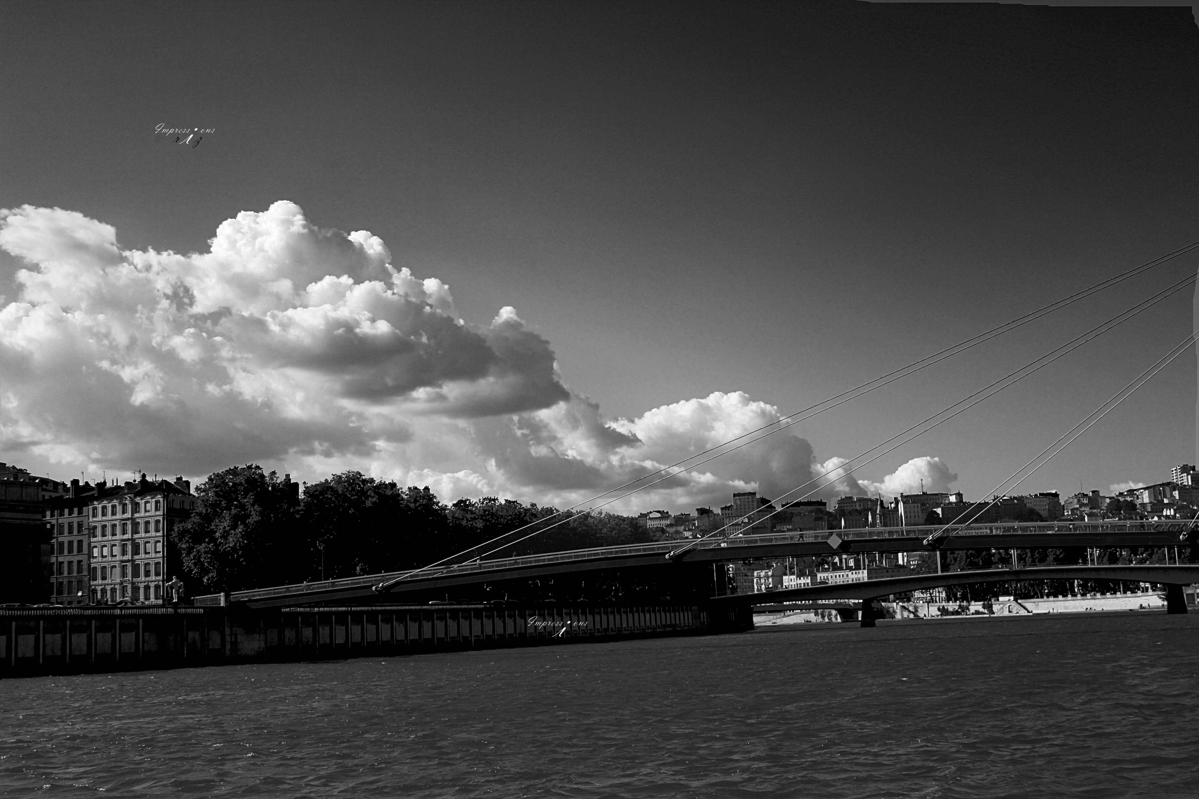
Image Image Data Basic Image Manipulation Histogram Image Segmentation Noise in images
Image Addition
Addition of two images
Original Image 2
31 / 92

Slide 4
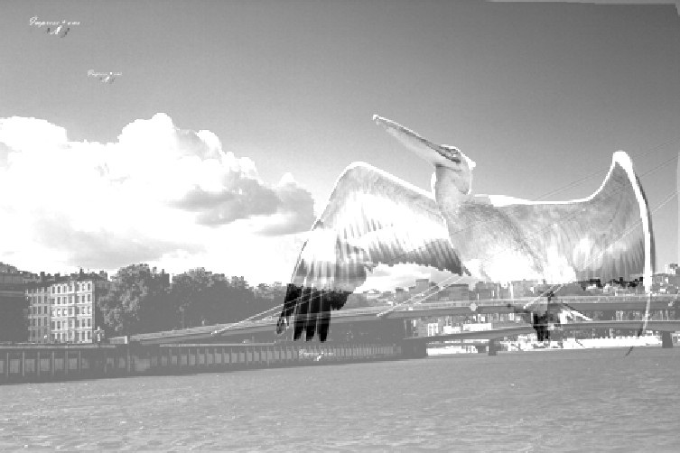
Image Image Data Basic Image Manipulation Histogram Image Segmentation Noise in images
Image Addition
Addition of two images
Summed Image
Before summing make sure size of images are same as addition is an element by element operation (corresponding pixels values are added together).
Resultant image is washed out. Why?
31 / 92

Slide 5
Image Image Data Basic Image Manipulation Histogram Image Segmentation Noise in images
Image Addition
Addition of two images : Matlab
1
2
3
4
5
6
7
8
Why image is washed out?
32 / 92

Slide 6
Image Image Data Basic Image Manipulation Histogram Image Segmentation Noise in images
Image Addition
Addition of two images : Matlab
Area in the images that are bright gets more brighter.
Scale image intensities (try
scaling by ¹ before adding
2
images in order to have max. 255 as resultant).
Exercise: Try to get better results!
32 / 92

Slide 7
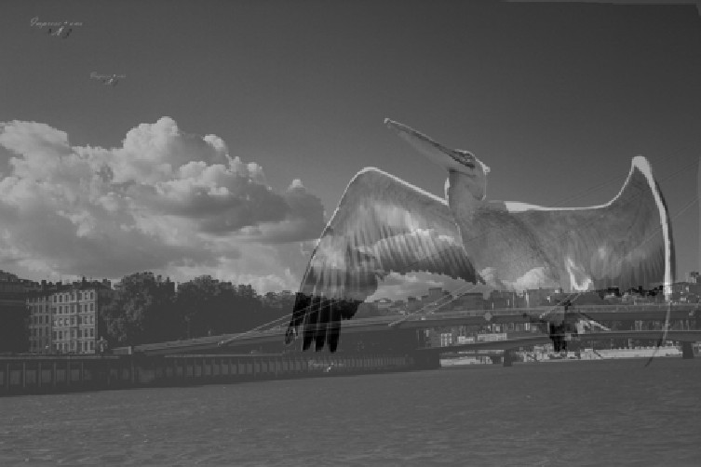
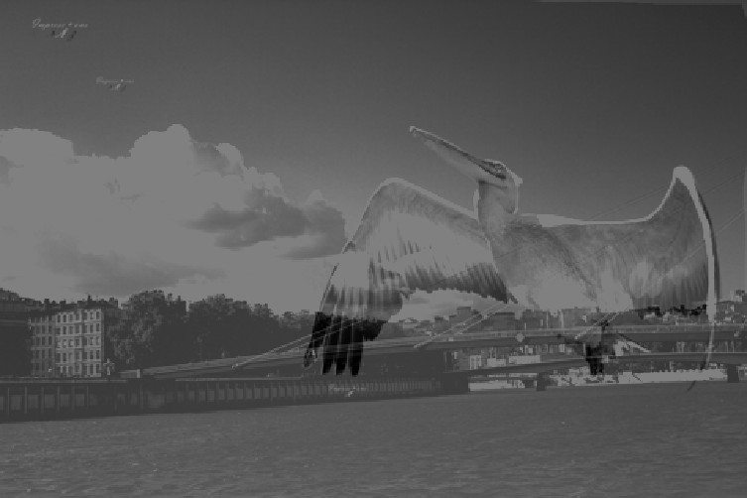
Image Image Data Basic Image Manipulation Histogram Image Segmentation Noise in images
Image Addition
Addition of two images : Details
image1 ₊ image2
2 2
image1+image2 2
Reason
Why result is different, although ^{A} + ^{B} = ^{A+B}
2 2 2
33 / 92

Slide 8
Image Image Data Basic Image Manipulation Histogram Image Segmentation Noise in images
Image Addition
Addition of two images : Details
image1 ₊ image2
2 2
image1+image2 2
Reason
Consider two pixel values to be added, 183 & 152.
¹ Method 1: ¹⁸³ + ¹⁵² = 168
2 2
² Method 2: ¹⁸³⁺¹⁵² = ³³⁵ = ²⁵⁵ = 128 (Anything above 255 is truncated to 255 as image is 8 bit (uint8)).
2 2 2
33 / 92

Slide 9
Image Image Data Basic Image Manipulation Histogram Image Segmentation Noise in images
Blending Images
Blending (Average) two images
Original Image 1

Slide 10
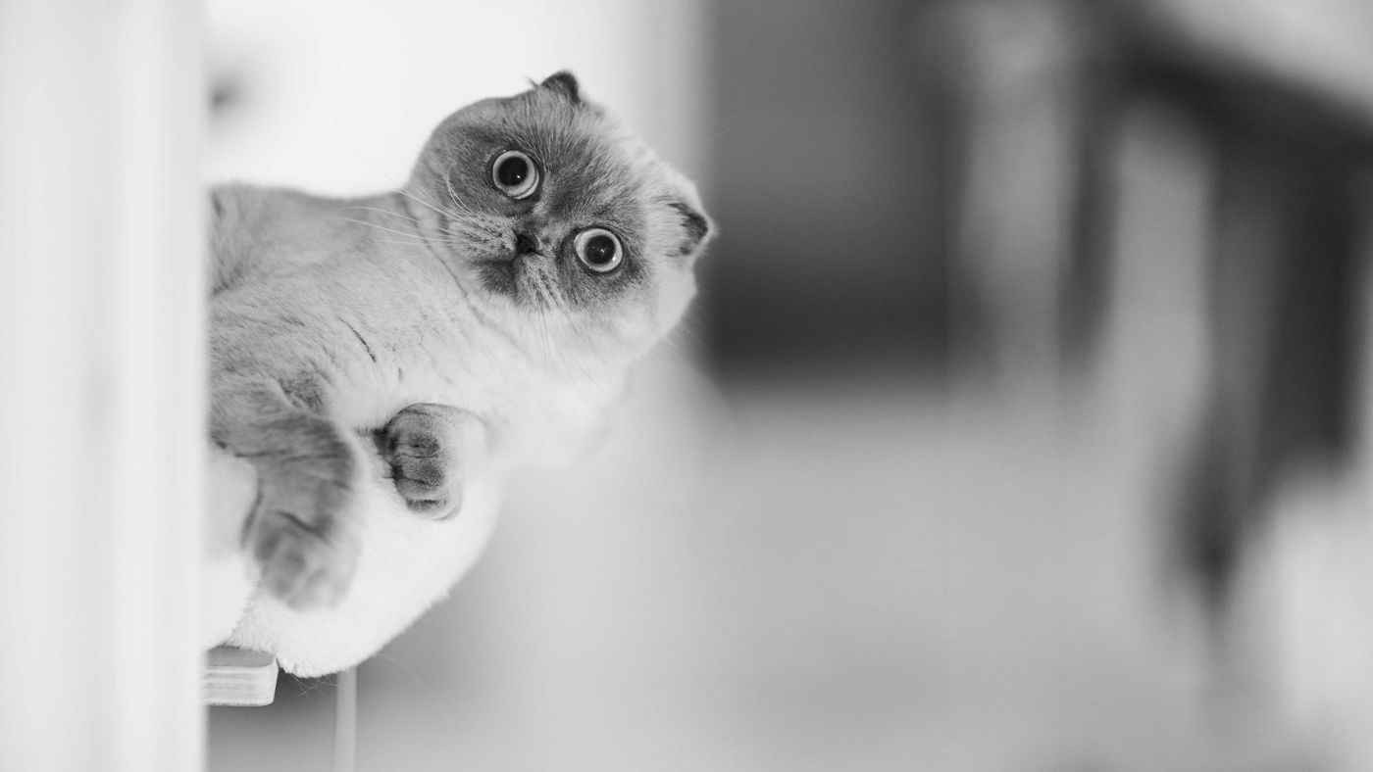
Image Image Data Basic Image Manipulation Histogram Image Segmentation Noise in images
Blending Images
Blending (Average) two images
Original Image 2

Slide 11
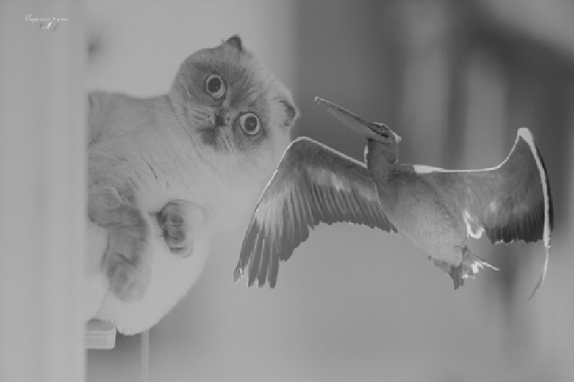
Image Image Data Basic Image Manipulation Histogram Image Segmentation Noise in images
Blending Images
Blending (Average) two images
Blended Image: 50% image1 + 50% image2

Slide 12
Image Image Data Basic Image Manipulation Histogram Image Segmentation Noise in images
Blending Images
Blending (Average) two images

Slide 13
Image Image Data Basic Image Manipulation Histogram Image Segmentation Noise in images
Blending Images
Blending (scaling) two images
Variable scaling
Blended Image: 50% image1 + 50% image2
Dr. Rizwan Ahmed Khan, https://sites.google.com/site/drkhanrizwan17/
35 / 92

Slide 14
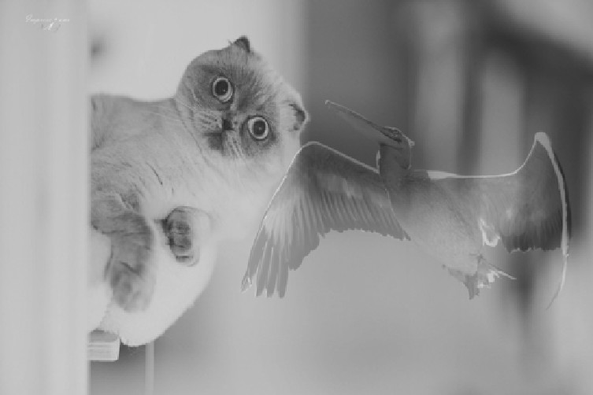
Image Image Data Basic Image Manipulation Histogram Image Segmentation Noise in images
Blending Images
Blending (scaling) two images
Variable scaling
Blended Image: 30% image1 + 70% image2
Dr. Rizwan Ahmed Khan, https://sites.google.com/site/drkhanrizwan17/
35 / 92

Slide 15
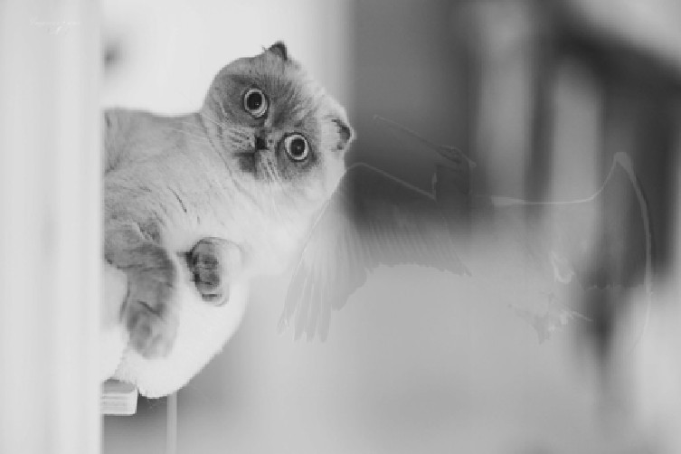
Image Image Data Basic Image Manipulation Histogram Image Segmentation Noise in images
Blending Images
Blending (scaling) two images
Variable scaling
Blended Image: 10% image1 + 90% image2
Dr. Rizwan Ahmed Khan, https://sites.google.com/site/drkhanrizwan17/
35 / 92

